Slide 1
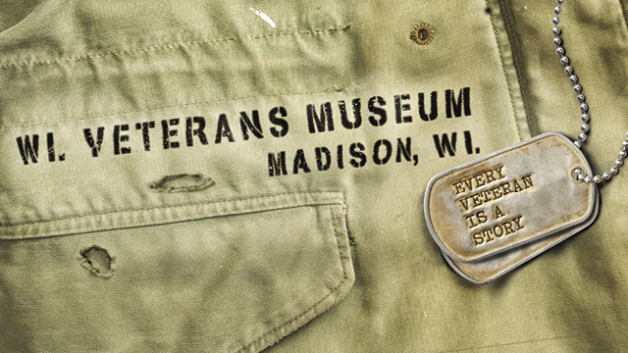
Wisconsin Veterans Museum

Slide 2
Why Do We Commemorate Veterans Day?
Formally known as Armistice Day (marking the end of World War I)
It was a day to be, “…filled with solemn pride in the heroism of those who died in the country’s service, and with gratitude for the victory, both because of the thing from which it has freed us and because of the opportunity it has given America to show her sympathy with peace and justice in the councils of nations.”
- President Woodrow Wilson
Changed to Veterans Day in America on June 1, 1954
A National day of observance to honor our military veterans

Slide 3
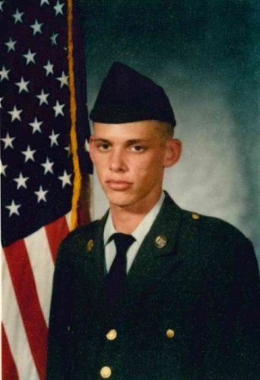
Pvt. Wright (Day 3 of Basic Training)

Slide 4
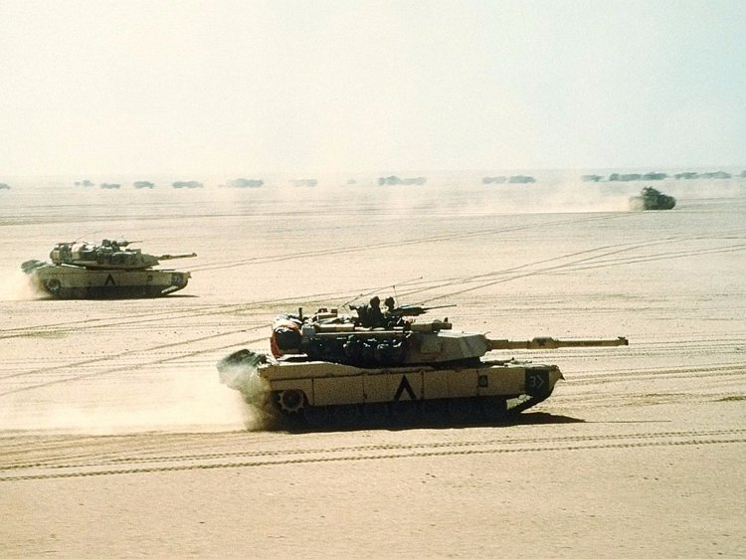
Operation Desert Storm (January 3-June 28, 1991)

Slide 5
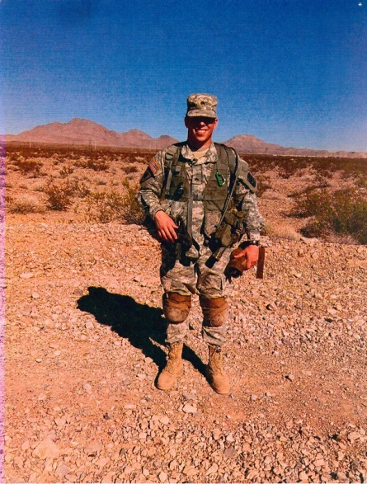
U.S. Army (Rebel Battalion) Cadet Wright

Slide 6
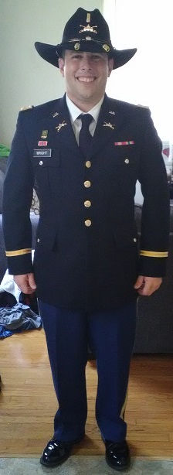
2LT Damian Wright

Slide 7
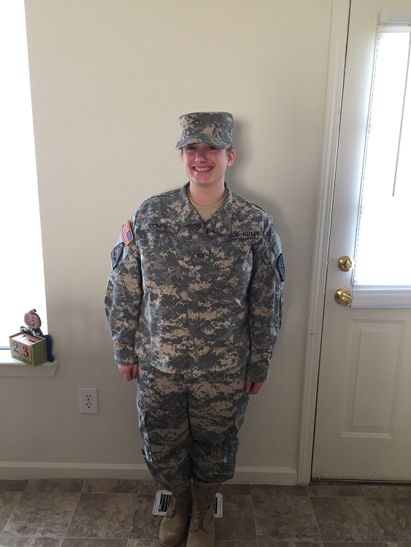
U.S. Army (Chippewa Battalion) Cadet Wright

Slide 8
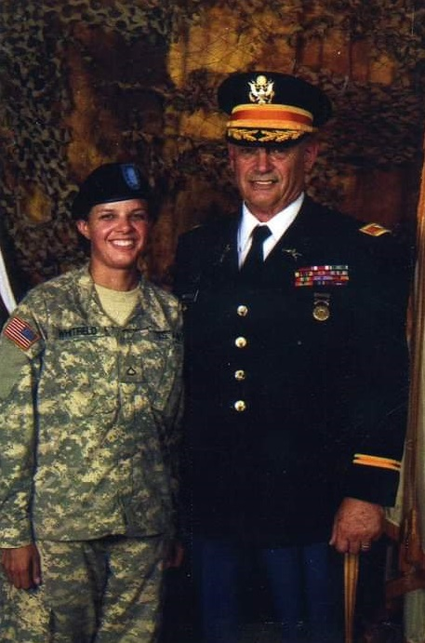
Sergeant and Colonel Whitfield

Slide 9
Questions
Erik Wright
erik.wright@dva.wisconsin.gov

Slide 10
WisVetsMuseum.com

